Slide 1
Physics-Informed Data-driven Modeling of Dynamical Systems on Graphs
Yin Yu
Dr. Daning Huang (Chair)
Assistant Professor
Department of
Aerospace Engineering
Dr. Puneet Singla
Professor
Department of
Aerospace Engineering
Dr. Yan Li
Assistant Professor
Department of
Electrical Engineering
Dr. Suhang Wang
Assistant Professor
College of Information
Sciences and Technology

Slide 2
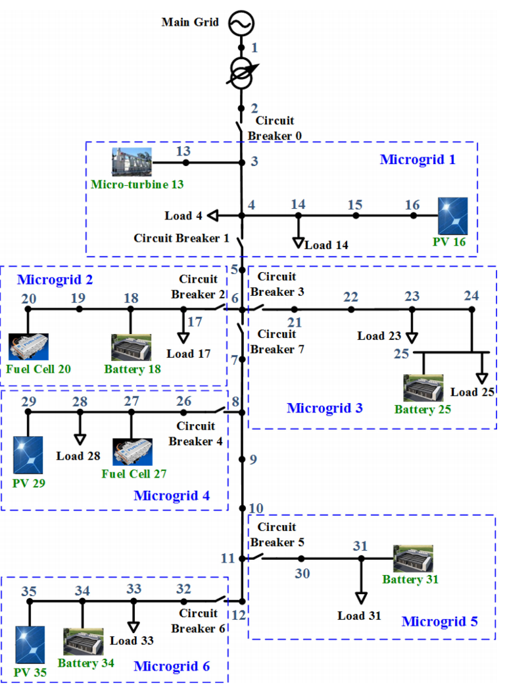
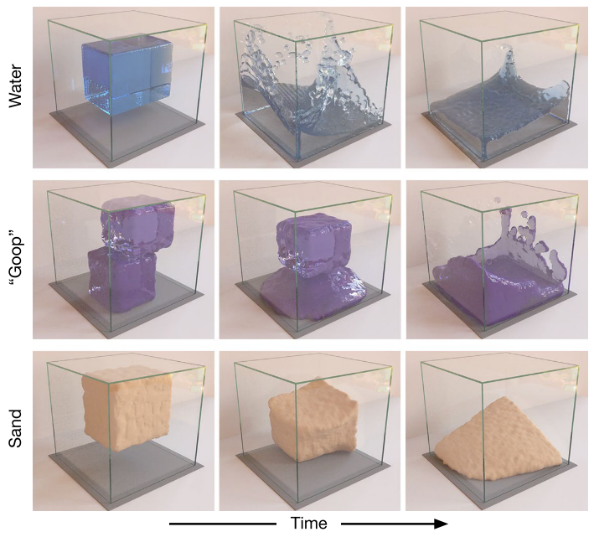
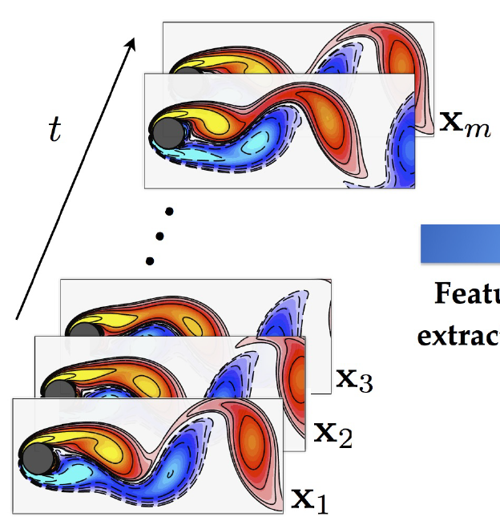
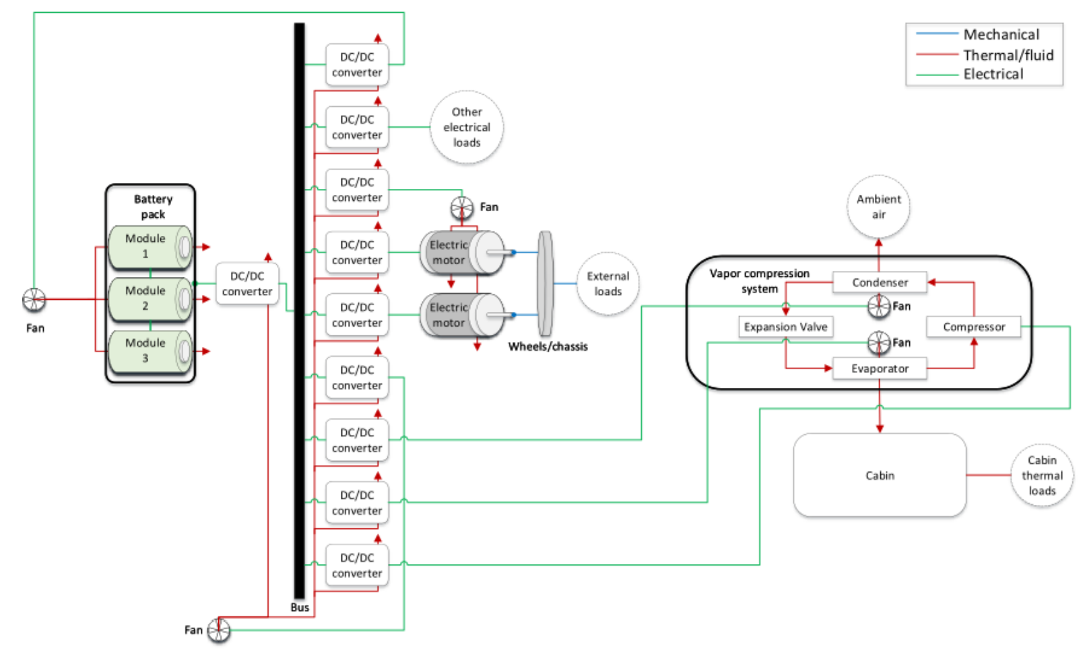
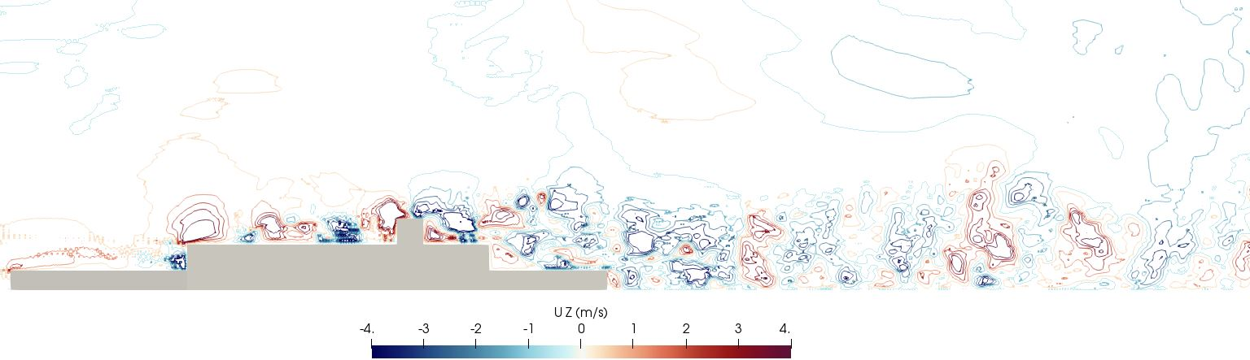
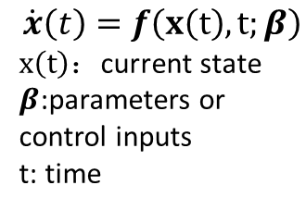
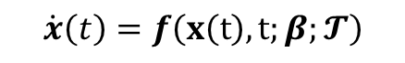
Dynamical Systems
Li et al. IEEE2017
$$\dot{x}\left(t\right)=f\left(x\left(t\right),t;β;𝓣\right)$$
$$\dot{x}\left(t\right)=f\left(x\left(t\right),t;β\right)$$
$x\left(t\right)$：current state
$β$:parameters or control inputs
t: time
Brunton et al. PNAS2016
Sanchez-Gonzalez et al. ArXiv2020
Yu et al. AIAA-ST22
Tannous et al. ACC2019
Notes:
Dynamical systems provide a mathematical framework, through differential equations and iterative mappings, to describe physical systems that evolve in time.
It can be defined through a set of ODEs, where the change of states in a system at certain time is characterized by some function f of the current state, time, a set of parameters.
Dynamical systems can be seen in many Engineering applications, some examples include fluid dynamics, thermal dynamics, power systems, and particle dynamics.
In the past, the modeling of dynamical systems is primarily physics-based, where the equations of motion can be derived from first principles. But the systems we are interested in today are much more complex, for many of which the equations that describe the system don’t even exist. This motivates alternative approach such as data-driven techniques.
Today, there still exist some major challenges in the modeling of dynamical system. The biggest challenge is arguably the nonlinearity of the system dynamics. Also, for complex systems, we often have to deal with very high dimensional variables with large degree of freedoms. This becomes even harder if we want to bring control or design optimization to the table.
Methods are developed and established for some regular systems with well-known patterns, but that is not the case for systems with more complex topology. Furthermore, it is worth exploring the additional information hidden in the system topology to improve the performance and expressiveness of our models.

Slide 3
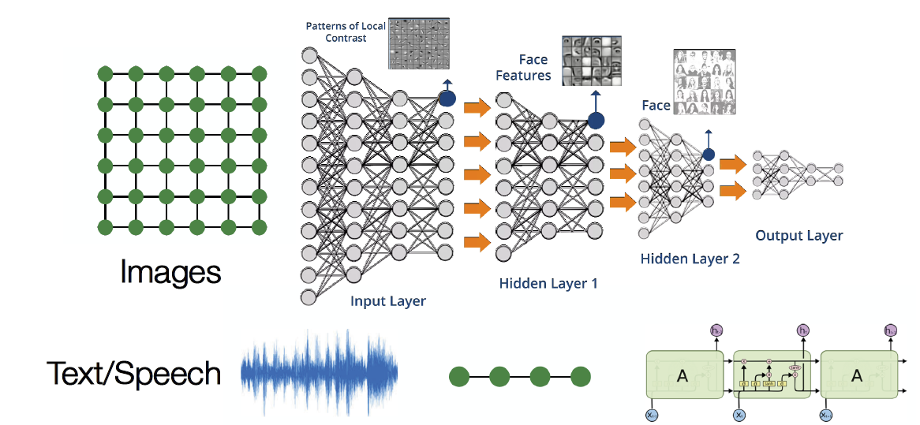
Modern Machine Learning Toolbox
M
Pic Ref: Jure Leskovec, “Stanford CS224W: Machine Learning with Graphs”, 2020
Notes:
ML is the field of algorithms that allow computers to learn from sampled data to perform tasks without being explicitly programmed and has caused a paradigm shift in the scientific and engineering applications.
2. Conventionally, such applications have focused more on theory development and experiments. High-fidelity physical models usually take years to design and refine, and have extremely high computational cost. Nowadays, with the increasingly available
scientific data and the rapid advance of machine learning algorithms, data-driven approaches start getting more attentions.
3. Conventional machine learning methods are tailored for simple data with fixed topological structures, like text or images. For example, CNN is well established in various of image processing tasks, and RNN specializes in sequential data processing in space or time.
4. But in real world, many data come with various size and topology, and has no fixed spatial locality.

Slide 4
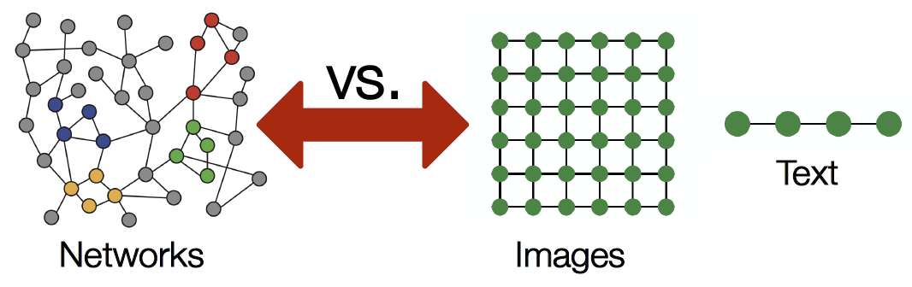
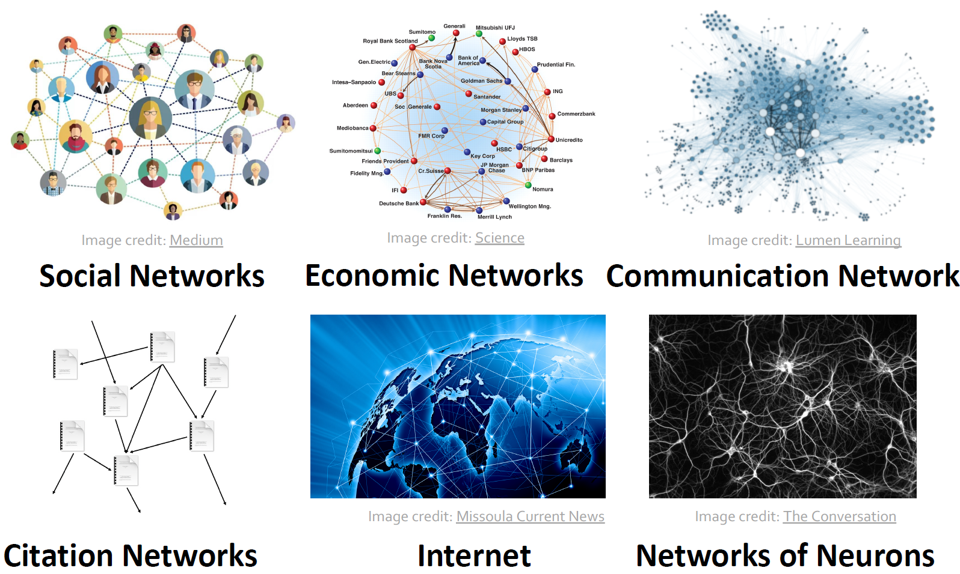
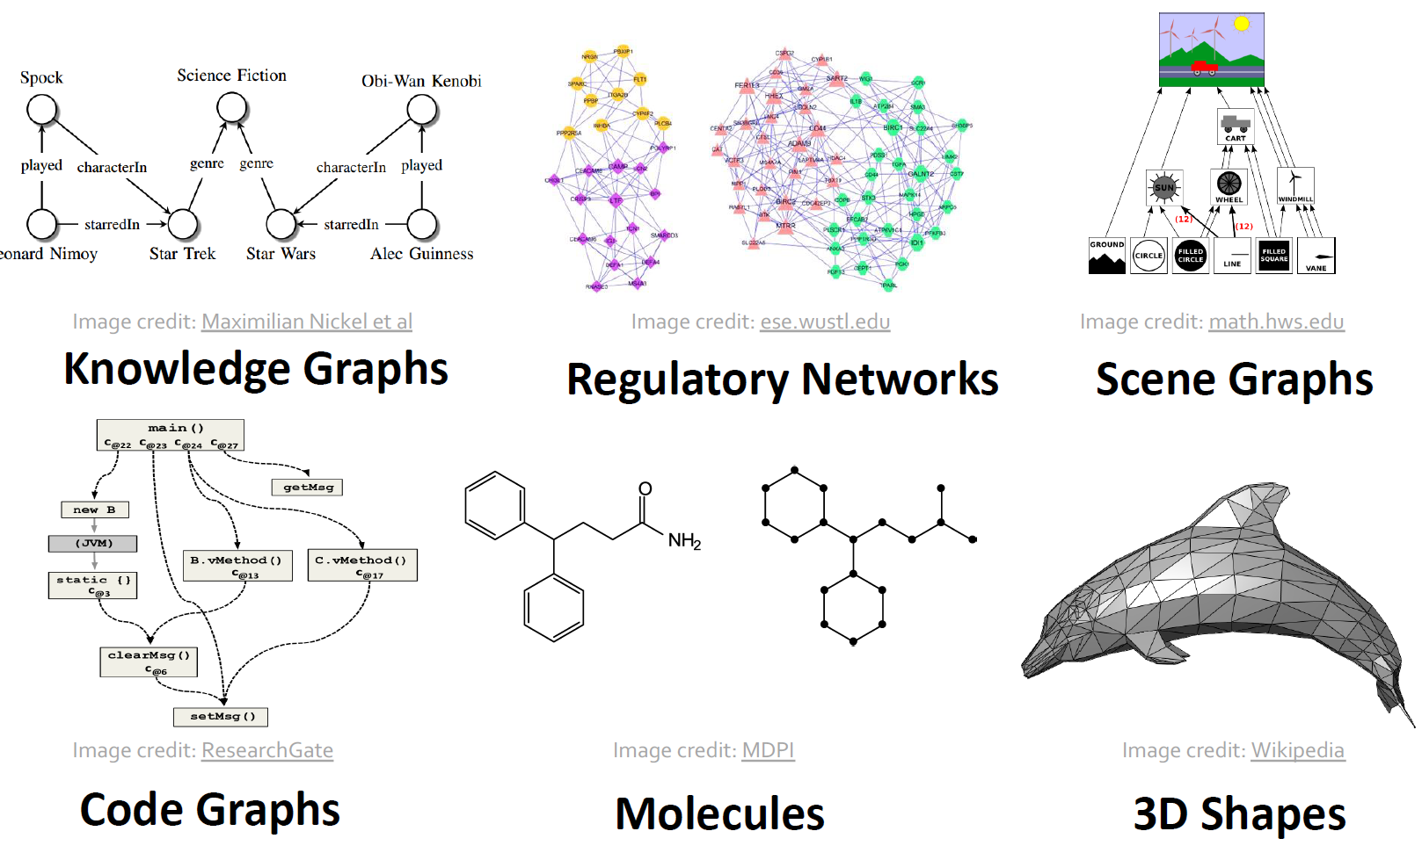
Data on Graphs
Jure Leskovec, “Stanford CS224W: Machine Learning with Graphs”, 2020
Notes:
Graph data structure models a set of objects and their relationships and provides a universal representation of data. Real world objects across various fields are often defined in terms of their connections to others, therefore by nature can be expressed by graphs. Meanwhile, numerous other types of data can be transformed into graphs so that the relationships of the objects can be utilized. Such examples are shown in the figures.
In practice, graphs are often dynamic in structure, and have multi-dimension features on their nodes, even edges. Graphs therefore expand the way underlying data are presented, but also creates many challenges for existing machine learning algorithms. In order to make use of this additional information in the data, new techniques are needed.

Slide 5
Learning on Graph

Slide 6
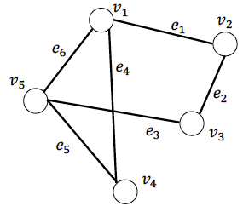
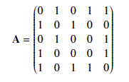
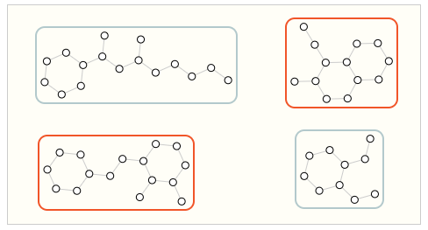
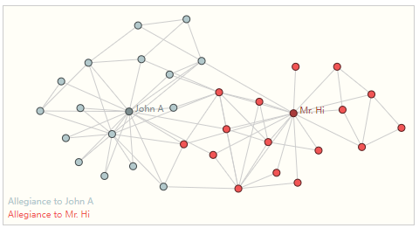
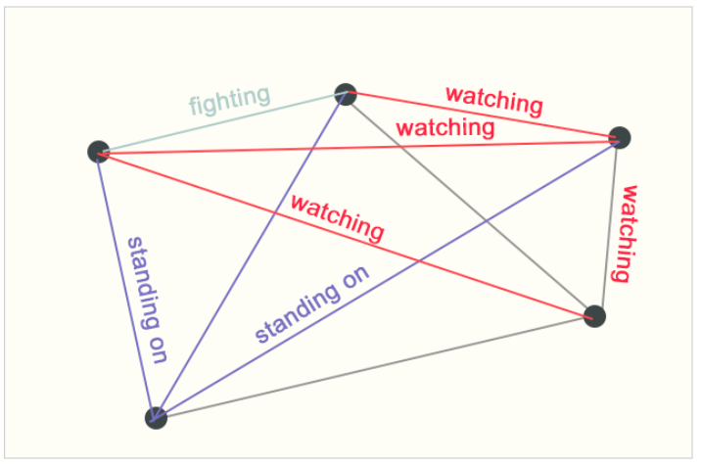
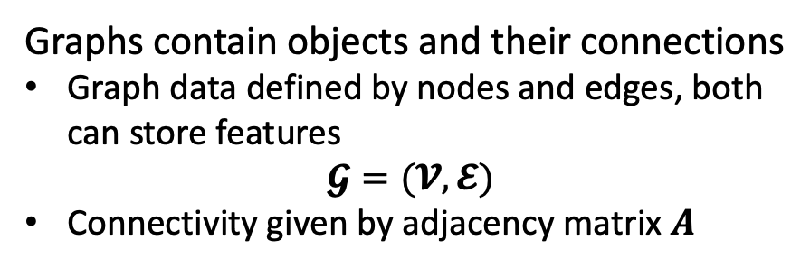
Graph Representation
Graphs contain objects and their connections
Graph data defined by nodes and edges, both can store features
$$𝓖=(𝓥,𝓔)$$
Connectivity given by adjacency matrix $A$
Ma et al., “Deep Learning on Graphs”, 2021.
A graph data structure and its corresponding adjacency matrix.
Three types of prediction tasks on graphs: graph-level, node-level, edge-level.
Sanchez-Lengeling, et al. URL:https://distill.pub/2021/gnn-intro/
Notes:
The graph data structure is unique because it not only contains the objects, but also the information on how these objects are connected. This is one of the main reasons why we want to use this specific data structure, as the additional connectivity information can be explored for more accurate modeling of the underlying phenomena of the systems.
A graph is therefore defined by nodes that represent the objects, and edges that represent connections. For a given graph, its connectivity can be written in the form of adjacency matrix. In many cases, we consider simple graphs where at most one edge exists between each pair of nodes, and the edges are all undirected, and in those cases the adjacency matrix is symmetric. The graph connectivity can also be expressed by the Laplacian matrix L, which is defined by the subtraction of adjacency matrix from the degree matrix.
There are in general three types of prediction tasks on graphs, graph-level, node-level ,and edge-level.
(click)Graph-level tasks are concerned with predicting the property of an entire graph, where data often consists of a set of graphs, and each sample is one graph.
(click)In node-level tasks, there is typically only one large given graph, and the task is to learn and predict the identity or role of each node within the graph.
(click)In edge-level tasks, one’s interest mainly focus on the prediction of connections between nodes, and how strong the connections are.

Slide 7
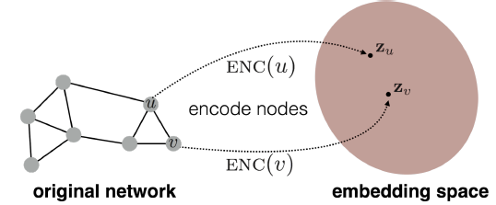
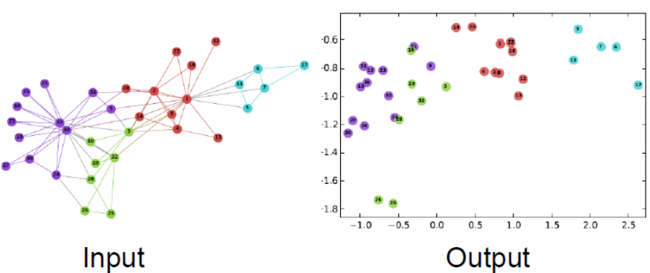
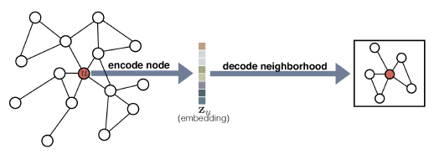
Graph Embeddings
Traditional ML for graphs requires task-dependent manual feature extractions.
Graph representation learning does this automatically, and task-independent.
Features are mapped to a d-dimensional embedding space.
Hoff et al. JASA2002
2D node embeddings of Zachary’s Karate Club network
Hamilton et al. IEEE Data Eng. Bull. 2017
Perozzi et al. KDD2014
Notes:
There are ways to use traditional ML techniques on graphs, but for an input graph, one needs to extract node, link, and graph-level features, and learn a model that maps features to labels. This is a cumbersome manual process that needs to be done for every problem.
This motivates the idea of graph representation learning, which can extract features automatically from graphs in a task-independent fashion.
This involves representing the nodes in a graph with d-dimensional latent vectors, called node embeddings, through an encoder, which is typically a neural network.
The latent vectors are optimized through learning so that the distances between nodes in the latent space reflect the actual relative positions of the nodes in the original graph. This way, the topological information and the structure of the local neighborhood of the original graph are preserved.
One major advantage of node embeddings is that they are task-independent. Once the nodes are mapped to the embedding space, many downstream tasks, such as classifications, and link predictions, can be performed in a much more efficient way.
(click)An example of such operation is shown, where the node features of a small network are encoded into the embedding space. Here you can see that the nodes in the original graph are color-coded, and after the embedding, most of the nodes that were close to each other stay close in the latent space.

Slide 8
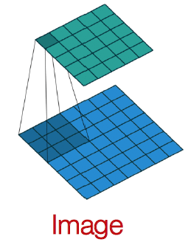
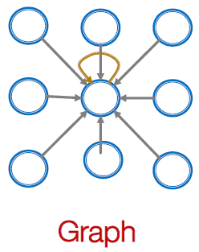
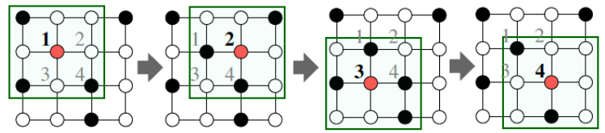
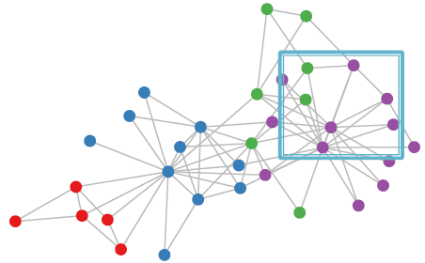
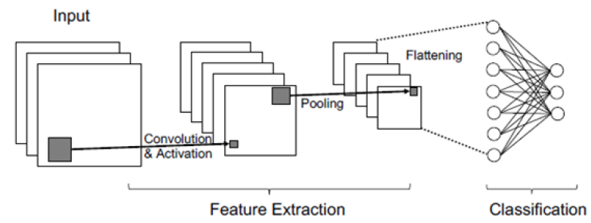
Graph Convolution
Graphs come with arbitrary topologies, with no fixed notion of locality or sliding window available.
Not directly applicable to graphs
2D convolution (CNN) on an image
Ref. Jure Leskovec, “Stanford CS224W: Machine Learning with Graphs”, 2020
Notes:
One naïve approach of dealing with graph is to join the adjacency matrix and features, and feed them all into a DNN. But this approach creates a huge number of parameters, and is not applicable to graphs of different sizes.
In CNN, we define the convolution filters (small windows), and slide them through the entire image to generate the feature maps. (click) Because the graph topology is complex, there is no way to define the notion of a fixed-size window, or how to slide it.
But CNN still gives us hints on how this can be done. (click) In CNN, what the convolution filters do is to take the information of all the neighboring pixels and combine them to a new feature. So to generalize this operation to graphs, the network needs a way to transfer information from neighbors, and combine them to update.

Slide 9
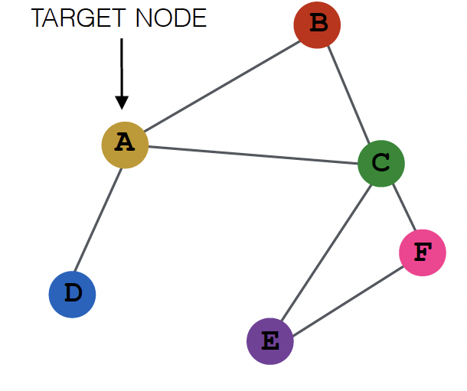
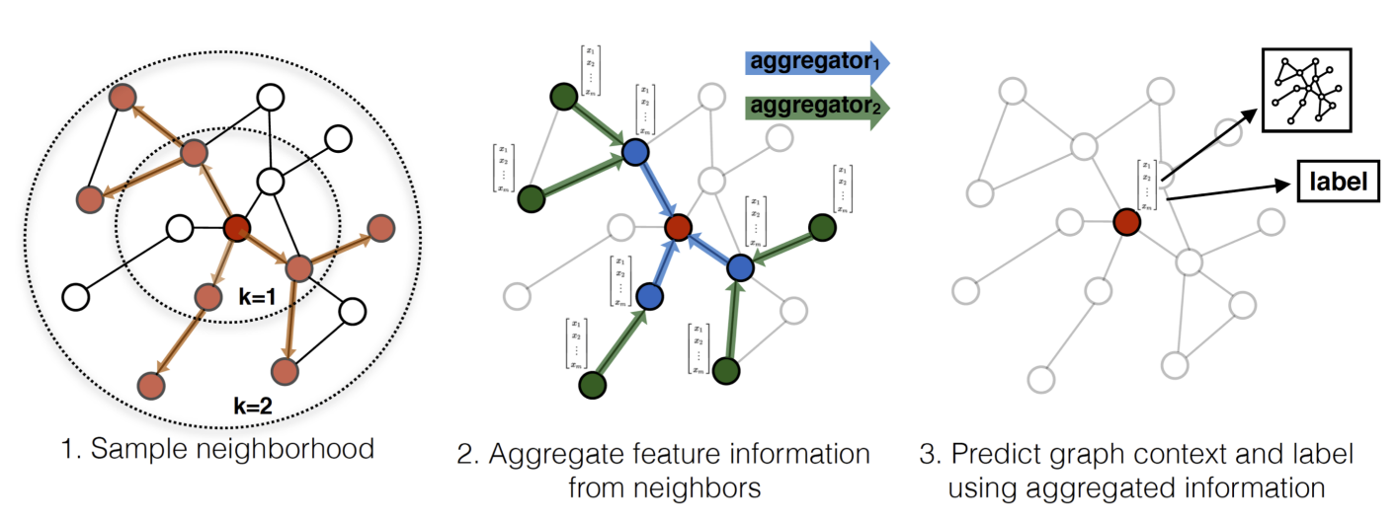
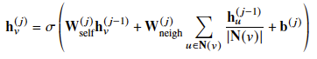
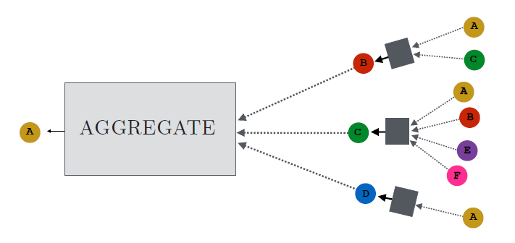
Graph Neural Network (GNN)
Input graph
The defining feature of a GNN is the usage of a form of message passing.
William et al. NIPS2017
Aggregator
Computational graph
Ref. Jure Leskovec, “Stanford CS224W: Machine Learning with Graphs”, 2020
Notes:
1. Graph neural network is a type of neural network that can work directly with graph data. The basic GNN can be motivated in a number of ways, for example as a generalization of convolutions to non-Euclidean data, or a differentiable variant of belief propagation, but nonetheless, the defining feature of a graph neural network is that it uses a form of message passing, where the vector messages are exchanged between nodes and updated using neural networks. The key idea is to generate node embeddings based on local network neighborhoods, and therefore it can also be viewed as a form of deep encoder for embeddings.
2. (click)This is a two-step process. The network will first create the computational graph based on the input graph. These two are different because for each target node, the graph structure of the local neighborhood is different.
3. Then it uses the message passing mechanism to aggregate information. For example, when the network updates the information on node I, it will take information from its neighbors, and neighbors from neighbors of neighbors. So the information can propagate along the edges and aggregated for updates.

Slide 10
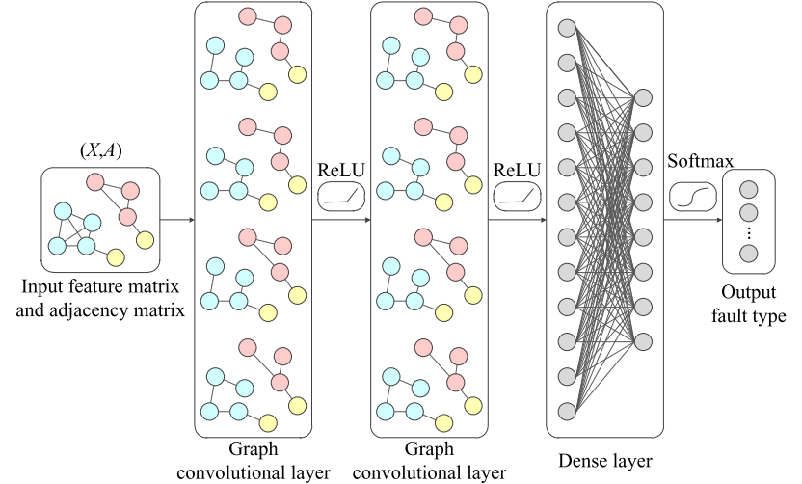
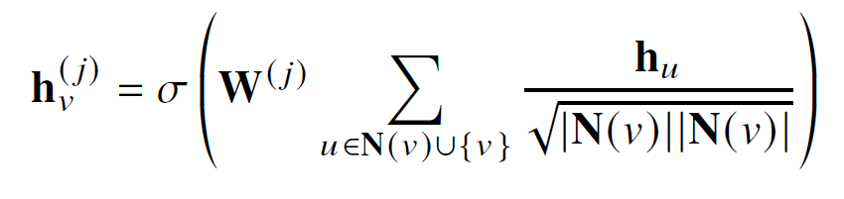
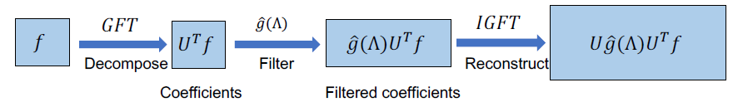
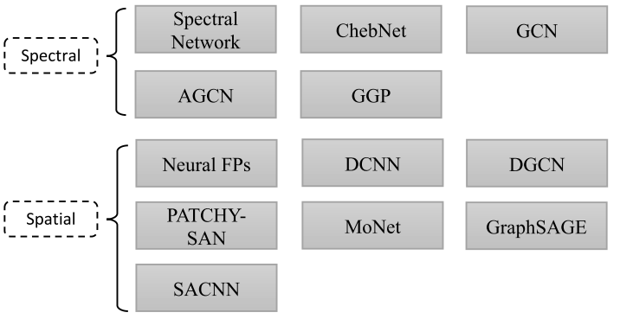
Graph Convolutional Network (GCN)
One of the most popular baseline GNN models.
Symmetric-normalized aggregation and self-loop update approach.
Two groups: spectral and spatial.
Liao et al., ArXiv2021
Ma et al., “Deep Learning on Graphs”, 2021.
Graph Fourier transform (GFT) used in spectral convolutions.
Zhou et al., AIOpen2020
Notes:
The GCNs proved to be one of the most effective and popular GNN architectures. The convolution operations on graph can be roughly divided into two groups: spectral convolutions and spatial convolutions.
In the previous slide, the architecture shown is taken from the GraphSAGE, which belongs to the spatial convolution category. The spatial methods work directly with the graph structure and uses the adjacency matrix A
(click)For the spectral methods, the convolution is defined in the spectral domain, which is achieved by applying a Graph Fourier Transform (GFT) on the eigenvalues of the Laplacian matrix L.
To reduce the computational effort, Hammond et al proposed to use a truncated expansion of g with Chebyshev polynomials up to the Kth order. This idea is used to create ChebNet, which eliminates the need of performing eigendecomposition of L, and the depth of MP can be controlled by the order of K.
There are a few potential drawbacks in the spectral methods, one being the high computational cost associated with the forward and inverse GFT, second is they are unfavorable to dynamic graphs, as any change to the graph structure causes the eigenbasis to change. They are also mostly limited to undirected graphs with no edge features.

Slide 11
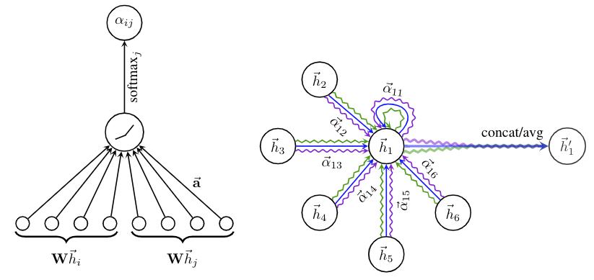
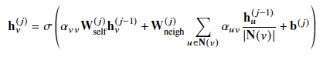
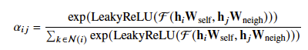
Graph Attention Networks
Uses attention mechanism to determine which neighbors are more important by specifying different attention weights.
Velickovic et al. ArXiv2018
Attention weights
Notes:
Another variation of spatial convolution framework is the Graph Attention Network (GAT) proposed by Velichovic et al, where they added the attention mechanism to the GNN.
[The attention mechanism in some sense weighted message passing where the weights depend on neighbor information.]
The attention mechanism was previously used mainly in sequence-based tasks such as NLP, where it showed significant improvements over some other methods.
Here, the GAT consists of arbitrary layers of graph attention layer where a pairwise attention coefficient between two nodes is added in the aggregation step. The aggregation operation now becomes a weighted sum of the neighboring node embeddings instead of equal ones, determined by the attention coefficients that are trained simultaneously with other free parameters in the network.
This leads to the key difference between GAT and other GCNs that, with the attention coefficients, the network can now determine the importance of neighboring nodes to a target node and perform aggregation accordingly.
The attention-based neural networks are also used in time series predictions, where attention coefficients are assigned to various spots of time sequence data and determine how much the data from a previous time step impacts the current.

Slide 12
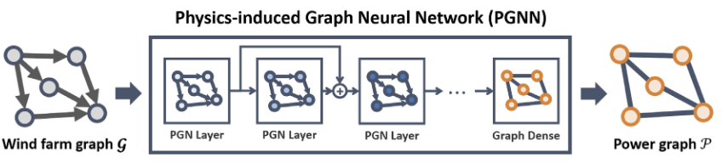
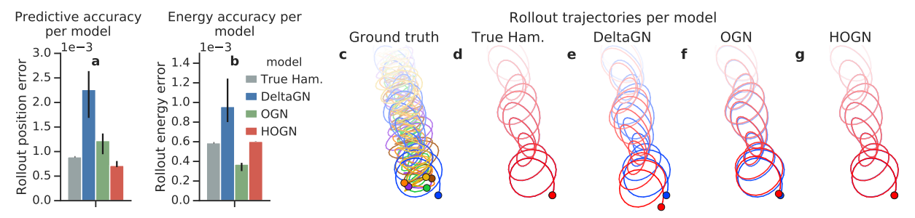
Physics-informed GNNs
Infuses known physics laws into loss functions to enhance training and prediction performance.
Park et al. Energy2019
Sanchez-Gonzalez et al. ArXiv2019
Notes:
The training of any neural network usually requires a great amount of data, but in the case of physics problems, data are often hard to come by. One way to tackle this is to somehow combine the known physics aspects of the system with data, which can be done by incorporating the established governing equations of physical laws to the model, as a form of constraint during a training process that must be complied with.
The class of physics-informed neural network were developed under such context. The idea is straight forward: to add the known differential equations in residual form directly to the loss function that is used to train the network, so that an optimized network should produce outputs that satisfy the physical law. Such modification to the neural network has proven to improve its ability to interpret physical systems tremendously.
This idea of physics-informed learning is also used in dealing with physical problems defined on graphs, and has shown to be critical for the predictive accuracy and generalizability of a machine learning model for physical systems.

Slide 13
Applications of GNNs in Dynamical Systems
Notes:
There have been a few applications of various form of GNNs in the multivariate time series predictions of dynamic
systems. This section focus introduces some of these applications in a number of domains.

Slide 14
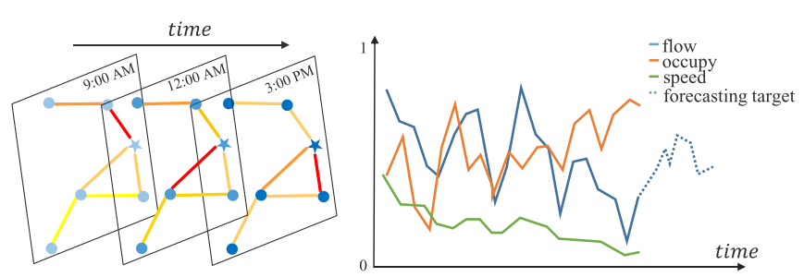
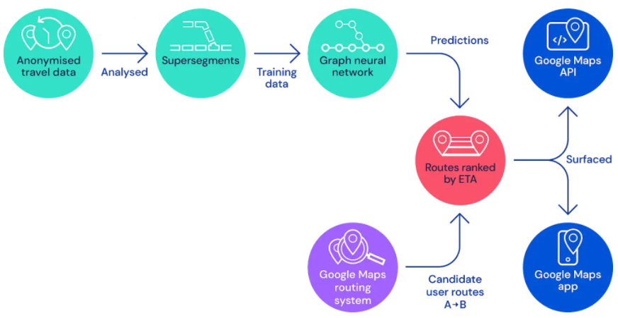
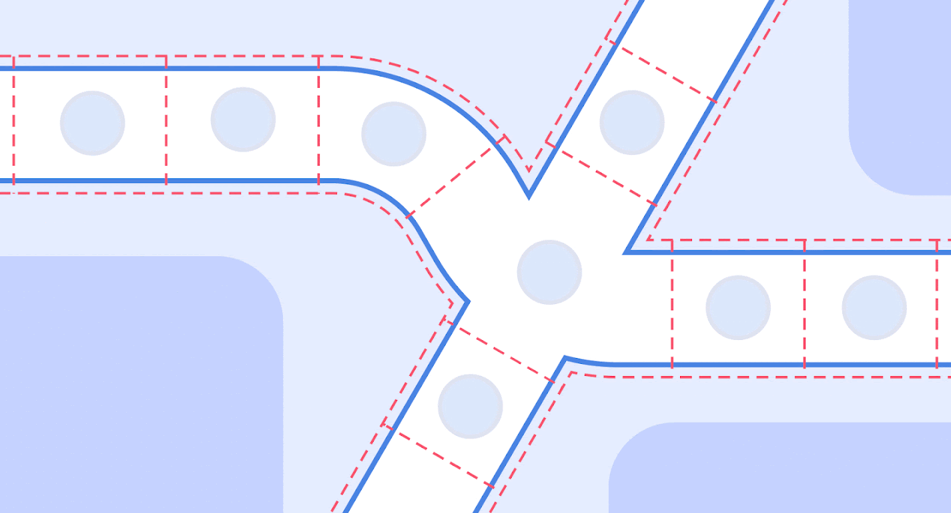
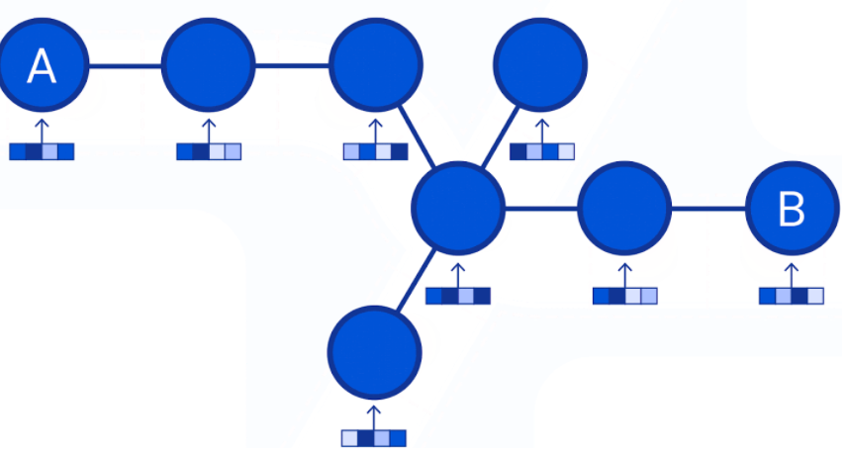
Traffic Flow Forecasting – 1
Guo et al. AAAI2019
Prediction of future traffic conditions given previous observations.
Road network as a graph.
Road segments with measuring stations.
Corresponding graph structure.
Lange et al. “Traffic prediction with advanced Graph Neural Networks”, DeepMind2020
Notes:
1. Traffic forecasting is a typical time-series prediction problem where predictions of future traffic conditions are desired given the previous observations. It is motivated by the growing need of transportation planning and management, and is a cruial part of the Intelligent Transporation Systems.
2. In the traffic study, indicators such as the traffic flow speed are typically monitored for current traffic condition, and series of data are collected over a period of time for analysis. The long-term traffic prediction, as well as the accurate real-time prediction of traffic conditions, have been difficult due to the highly complex dependencies in both space and time.
3. (click) The topological structure of the road network can be naturally defined as a graph, where measuring stations or road segments are nodes, and their pairwise connections are edges.
4. (click)Typically, the traffic condition forms a multi-dimensional state vector on each node that is available as snapshots for a period of time, as is used to train networks that can predict the traffic condition at a future time to help with decision making.

Slide 15
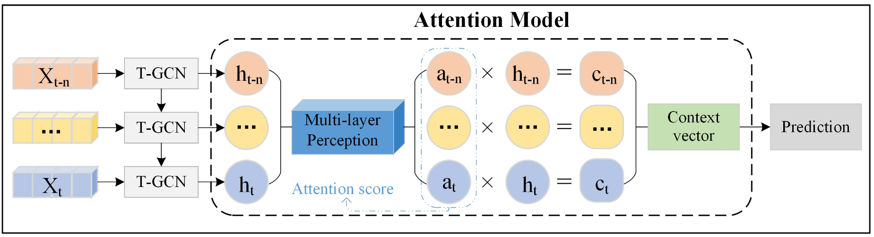
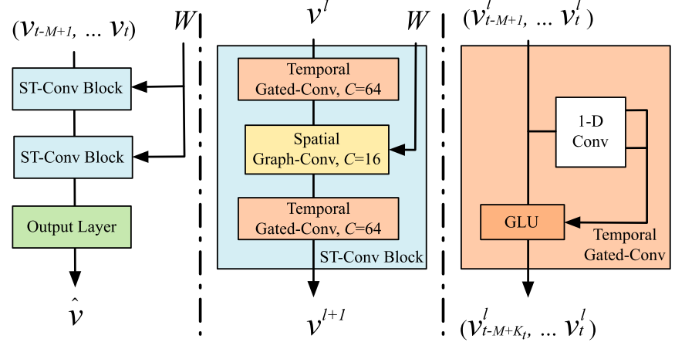
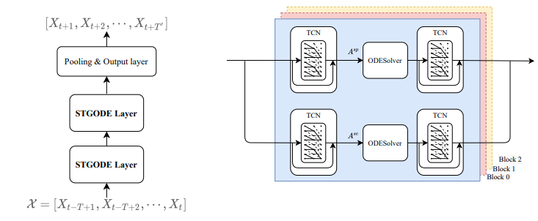
Traffic Flow Forecasting – 2
With attention mechanism
Spatial-Temporal GCN (STGCN)
Bai et al. ISPRS2021
Graph ODE network
Yu et al. IJCAI2018
Fang et al. KDD2021
Notes:
To tackle the complex dependencies in both space and time, Yu et al. proposed a RNN-based spatio-temporal graph convolutional network, or STGCN. In this architecture, the spatial features are extracted with a spectral-based convolutional layer, and the time dependencies are handled with gated linear units. This proposed model is evaluated with some real-world traffic datasets and showed better performance comparing to conventional methods such as SVM , or vanilla NNs.
Other improvement of this model includes the usage of attention mechanism, and the use of graph ODE network.

Slide 16
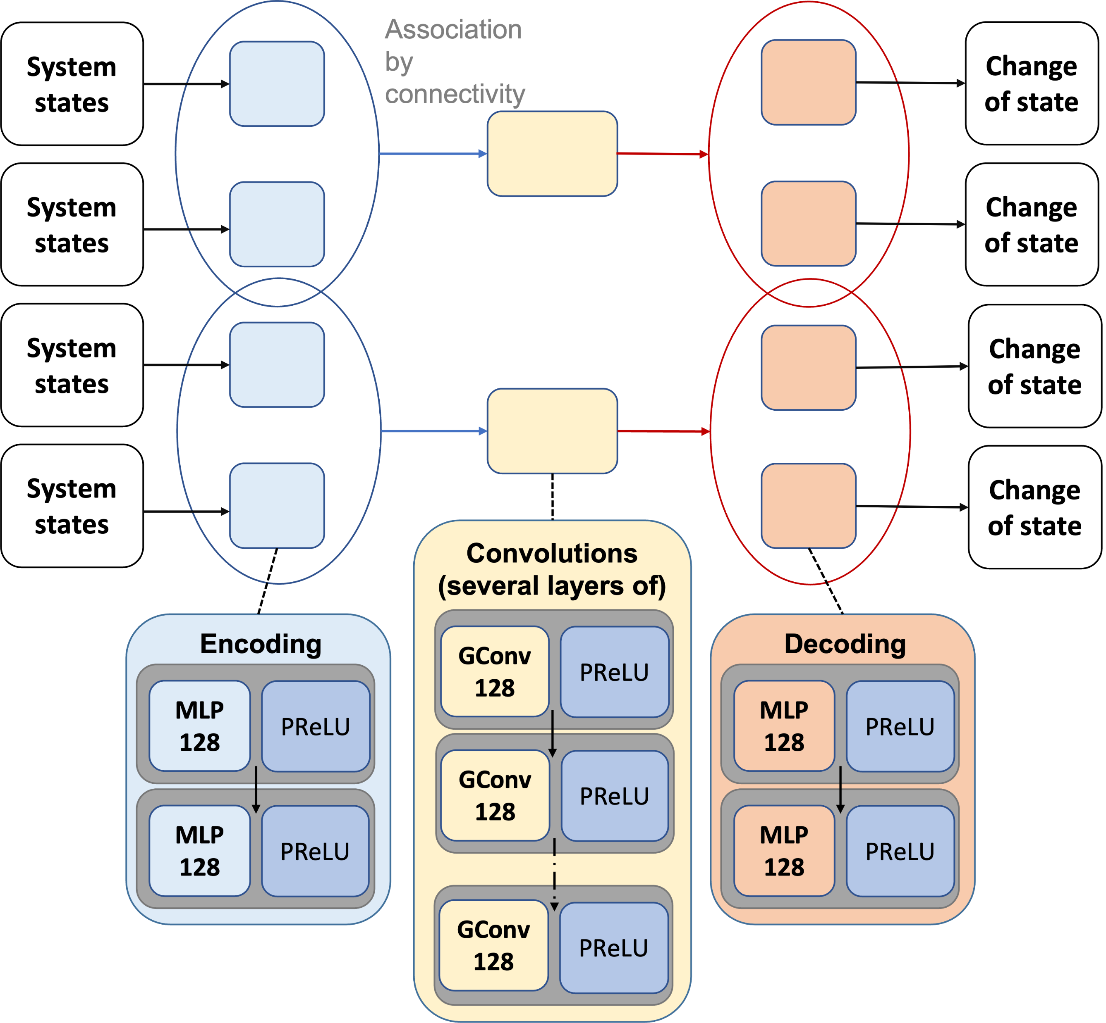
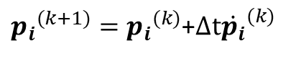
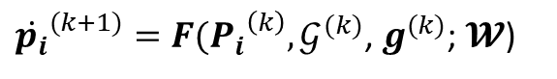
Power System
Collaboration with Xinyuan Jiang, Dr. Yan Li
Li et al. IEEE2017
${\dot{p_{i}}}^{(k+1)}=F({P_{i}}^{\left(k\right)},𝒢^{(k)}$, $g^{(k)}$; $𝓦$)
${p_{i}}^{(k+1)}={p_{i}}^{(k)}$+$Δt{\dot{p_{i}}}^{(k)}$
Notes:
The next case is a power system application, where we use the GNN to predict the dynamical response of a microgird. This is an ongoing work in collaboration with Xinyuan and Dr. Li here at PSU.
In the power system the graph data structure is more intuitive. We model the buses as nodes (generators, loads), then the lines between them as edges. Here we used the impedance of these lines as edge attributes.
3. At steady state of a power grid, the generators produce power that satisfies the consumptions on the load buses. When a load change occurs, TV turned on, or solar panel output changed due to weather condition, the outputs of the generators are adjusted accordingly to compensate for the change until a new equilibrium is reached within the grid.
4. We are interested in modeling the dynamics of the system in between the two equilibrium. We also used a physics-informed approach, where we added the power equation of voltage, current and impedance, as part of the loss function.
(click)For the time series prediction we are interested in, we use an encoder-processor-decoder architecture.
First the system states are mapped to a latent space to generate node embeddings. Then the processor performs message passing to aggregate neighborhood information based on locality. At last, the decoder maps the aggregated embeddings back to original space.
In this case, our network takes (click click click) the current states of the system, the graph structure at the current step, a global influence input, together with a set of trainable parameters, to produce the change of state at the current step, which is used to predict the state of the system at the next step. Such procedure is performed iteratively for the entire time series prediction.

Slide 17
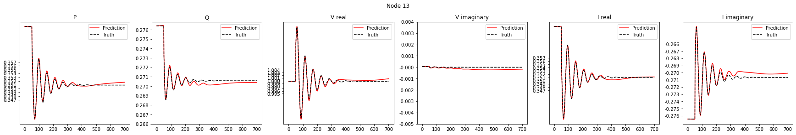
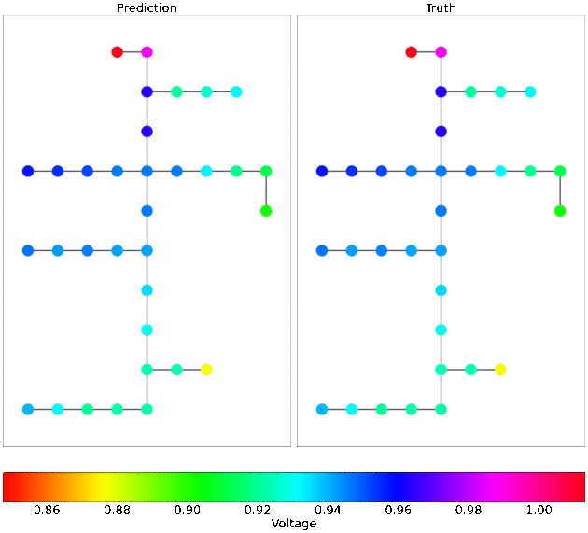


Microgrid Dynamic Response
Swing generator
Load
Generator
Notes:
Here we show what the dynamics of such change look like. Load change is induced at one or a few nodes, and the rest of the system react accordingly until a new steady state. The goal is to accurately predict the dynamics of the system in between
One challenge to point out is that in the time series prediction, the only ground truth data the model sees is the initial condition, and in each following step, the network uses the previous prediction as input, so the modeling error tends to accumulate. Most important part of the dynamics is well captured, amplitude accurate, no phase shift. Some deviation can be seen towards the end of the time series, and we are still working on improve this part.

Slide 18


Multi-body Dynamics
Multi-body system as a graph
Nodes: particles
Edges: interaction between particles
Predict: How a graph will evolve over time
Sanchez-Gonzalez et al. ArXiv2020
Notes:
In the previous applications, the graph structure of the system is constructed prior to the training and is independent of the network or time. Whereas in the case of many scientific and engineering disciplines, the underlying structures evolve with time as part of the system dynamics. Such topological changes in the systems represented in the form of dynamic graphs poses another challenge to the time series prediction of dynamical system with machine learning methods.
We start by looking at this mulit-body dynamics simulator that is developed by Gonzalez et al. at DeepMind, called the Graph Network-based Simulators (GNS). Here, the states of a physical system are represented as interacting particles, expressed as nodes in a graph, and the edges represent the interactions between particles. The system dynamics is learned through a series message passing among nodes, and the state of each node in the graph is characterized by a vector consists of its physical position and particle type.
To simulate the particle interactions, an inductive bias of invariance is implemented based on the absolute spatial location. Therefore, the underlying graph structure keeps evolving as the particle locations update in each time step, which is dynamically constructed with a standard nearest neighbor algorithm.
GNS is implemented with an encoder-processor-decoder architecture, where encoder and decoder are layers of MLP that map the particle states into latent space, and the processor consists of layers of GNNs that performs several rounds of message-passing over the latent graph.
The trained network is shown to be able to rapidly simulate system dynamics of a range of soild and/or fluid material, with the possibility of learning multiple materials and their interaction.

Slide 19

Fluid Dynamics – Dynamic Graph Network
① Convert Eulerian data to a Lagrangian representation (vortices)
② Learn the vortical interaction under Lagrangian frame
Yu et al. AIAA-ST22
③ Map back to Eulerian flow field from Lagrangian solutions
Notes:
The next application is in fluid dynamics. This is a work of our own, where we try to simulate the vortex dynamics of the wake region of a ship. This is for a study of the shipwake – helicopter interaction, which requires extremely high computational cost in CFD.
Here the vortical flow field is modeled as a graph, where the nodes are groups of vortices and the edges capture the vortical interactions.
The DGN model has a unique feature as it only need to learn the way th
e vortices interact with each other, and does not need to characterize the collective behavior of the vortices.
Furthermore, leveraging the universal approximation capability of the neural network, it is possible to capture not only the classical vortex interaction relation, but also the turbulence and flow separation effects that are missing in the conventional vortex methods.

Slide 20




Fluid Dynamics - Synthesized Ship Airwake
Yu et al. AIAA-ST22
Notes:
The DGN model is trained using the time history of the evolution of the vortices. Such data set of vortex dynamics can be extracted from either CFD or test data.
(click)This is a case where we need extra effort to create the graph from data. We use a procedure to identify the vortices in the flow field and represent them as vortex particles, and use the distances between each pair of particles as the edges.
The network takes the position and vortex strength of each particle, plus the connectivity, and predict the velocity of these particles, and then the time series prediction.
(click)The flow domain starts immediately after ship location, so the vortex dynamics are most chaotic near the lower left corner of the plots.
The DGN model shows very good prediction performance overall. The predicted trajectories almost replicate the ground truth. The only visible deviation happens in the wake region, which is expected because of the more complicated dynamics.
Time series prediction, so the modeling error tends to accumulate. But as it turns out the model performed quite well. This demonstrates the robustness of the trained DGN model.

Slide 21
Concluding Remarks

Slide 22

Challenges and Proposed Methodology
Problem
Challenges
Solutions
Goal
Physical processes
in industrial, engineering and scientific applications:
Efficient and accurate modeling and control of Dynamical systems
on Graphs
To reproduce physics:
Conservation laws,
Bifurcation characteristics
Inductive bias with
Nonlinear dynamical
systems theory
To capture non-local effects:
Long-range correlation between distant nodes
Regularized optimization for Sparse inverses
Robust, Precise, Prompt
Decision Making
To optimize and control:
Preserve spectral properties
Tackle high dim. parameters
Graph theory with
Hermitian Laplacians &
Efficient sampling methods
Notes:
In this presentation we reviewed an emerging field of machine learning method, the GNN, with the potential of performing real-time multi-variate time series forecasting of nonlinear dynamical system. Many existing applications approach this from a pure data-driven perspective, which may require a large dataset for training and do not guarantee generalizability. (click)To that end, we raise the question that, is it possible to apply GNN, fused with knowledge of physics, to enable efficient and accurate modeling and control of dynamical systems on graphs?
Some initial successes have been achieved for some applications, but there are still three outstanding challenges to be addressed.
(click)The first challenge concerns the reproduction of physical laws of a learning model. Such learning paradigm has been shown to be critical for the predictive accuracy and generalizability of a machine learning model for physical systems. However, it remains unclear how to reproduce the nonlinear stability properties, such as bifurcation and limit cycles, that can significantly impact the stable operations of the dynamical system.
(click)The second challenge is on the non-local effects on graph. The GNNs are versed to capture localized interactions between the neighboring nodes on a graph. However, in some scenarios, local changes on one node may induce global changes on the rest of node
(click)The third challenge concerns the possibility of applying design optimization and control to the dynamical systems. This requires the GNN to preserve the spectral properties of the system, as the periodic response existed in many dynamical systems are naturally represented using complex-valued parameters. It also requires the GNN to handle potentially high dimensional parameters in a computational efficient manner.
(click)We believe the successful tackling of the three challenges hinges on the introduction of proper inductive bias in GNN, which is the inherent mathematical structure or assumption of the model that emulates the physics. The architecture design will be guided by nonlinear stability theory, or specifically leveraging the center manifold theorem.
(click)To address the second challenge, a dual formulation representing the inversion of a graph will be developed. Utilizing a sparse pseudo-inverse formulation of Laplacians in the complex domain, it is possible to create a dual graph with the same nodes but with an augmented set of edges. And the sparsity of the formulation ensures the scalability of the GNN architecture to large scale graphs.
(click)For the third challenge, the key to preserve spectral properties is to properly incorporate complex-valued parameters into the network, and preserve it during training. This requires the understanding of the effects of complex graph Laplacians leveraging or extending the latest advances in graph theory. We also need to develop an efficient automatic differentiation procedure that preserves the complex-valued function during back propagation. And we hope to reduce the dimension of parameters with some efficient sampling methods.
(click)We are currently developing a novel GNN architecture following this roadmap, some initial success is achieved and demonstrated. We hope that the methodology developed in this process shall lead to a new, robust and scalable methodology for the modeling and forecasting of nonlinear dynamics on graphs.

Slide 23
Thank you.

